Slide 1
Sprint 3

Slide 2
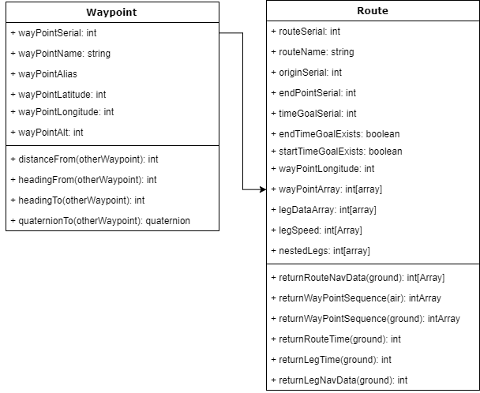




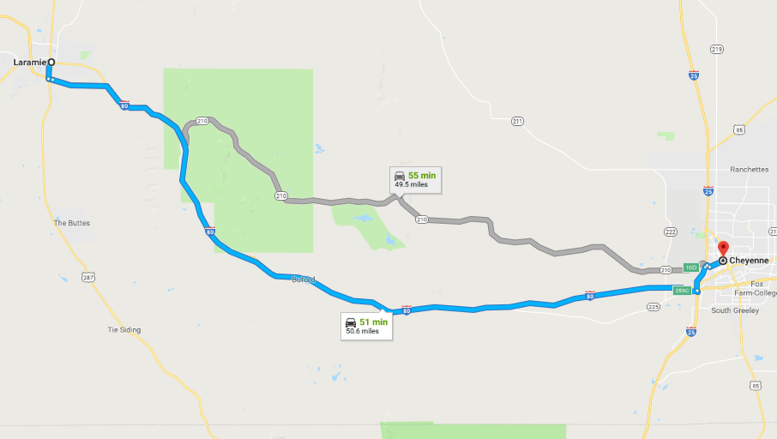
Add waypoint
List mode selected
List mode selected
Autosequence, no duplicates
Red: directly reports wpt parameter
12:38
12:38
ANVIL
ANVIL
Shortform of serial
MASTER WAYPOINT LIST
MASTER WAYPOINT LIST
User defined
WP#waypointSerial/ waypointAlias/ wayPointname
coordinates / altitude
Purple:
Coordinates translated frorm wpt model to UI
0001
WP#ac00001/ Alias: Pioneer/ Name: 001
13T DF 5143 7324/7185’
0002
WP#ac00002/ Alias: Pioneer/ Name: A01
13T DF 5143 7324/7185’
A189
CH4T
WP#ac00001/ Alias: Pioneer/ Name: 001
13T DF 5143 7324/7185’
Add Point Block :Activates when ‘Add Waypoint’ selected
WP#ac00001/ Alias: Pioneer/ Name: 0001
13T DF 5143 7324/7185’ Group: Navigation
WP# enter via keyboard
WP Name: alphanumeric 4 digit
WP Alias:
Lat:
Long:
Alt: (autogenerate from terraindata
WP#ac00001/ Alias: Pioneer/ Name: 0002
13T DF 5143 7324/7185’ Group: Navigation
Autosequence, not null, no duplicates
WP#ac00001/ Alias: Pioneer/ Name: CH4T
13T DF 5143 7324/7185’ Group: Navigation
WP#ac00001/ Alias: Pioneer/ Name: A189
13T DF 5143 7324/7185’ Group: Navigation
Autogenerate from last four of WP serial, allow key entry
Userdefined text string

Slide 3
Sequence up/down through routes
Sequence up/down through routes
12:38
12:38
ANVIL
ANVIL
ROUTE – 17-001[Tyrant45]//14.9 km
Origin: House C Dest: Target 4 TOT: 11:25:00z
ROUTE LIST
0
1
ROUTE – 17-001[Tyrant45]//14.9 km
Origin: House C Dest: Target 4 TOT: 11:25:00z
0
1
2
ROUTE – 17-001[Tyrant45]//14.9 km
Origin: House C Dest: Target 4 TOT: 11:25:00z
0
1
ROUTE – 17-001[Tyrant45]//14.9 km
Origin: House C Dest: Target 4 TOT: 11:25:00z
0
1
User-defined
ROUTE – 17-001[Tyrant45]//14.9 km
Origin: House C Dest: Target 4 TOT: 11:25:00z
Up triangle - origin
0
WP 17-001-00// House C
13T DF 5143 7324/7185’
waypointSerial of start point
0
1
110°
7.5km
05m25s
11:19:30
waypointSerial of end point
ROUTE – 17-001[Tyrant45]//14.9 km
Origin: House C Dest: Target 4 TOT: 11:25:00z
1
WP 17-001-01// none
13T DF 5344 7124/7270’
80kph
User entered time goal for start stop
0
Circle - turnpoint
1
Determines if time goal is for start or end point
ROUTE – 17-001[Tyrant45]//14.9 km
Origin: House C Dest: Target 4 TOT: 11:25:00z
2
WP 17-001-02// Target 4
13T DF 5344 7124/7270’
waypointSerial of all points
0
11:25:00z
1
down triangle - endpoint
Nested Array of calculated data between each waypoint pair:
Heading, distance, leg time, passage time
Accomodates detailed subroutes from api calls between user waypoints
Drives the leg speed calculation

Slide 4




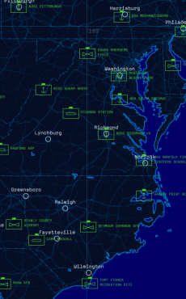


12:38
Scroll up-down to cycle through on-screen models
ANVIL
SEDAN – GEO PRISM/1999/BLUE
13T DF 5344 7124/7270’
Navigate to:
Activates wpt/route selction bar
Center map on model
DEST: 22S 154 832
ETA: 17:15:22
ROOSTER
440’A 88%
RTH: LOC DELTA
BINGO: 24%
Scroll up-down to cycle through wpts,routes
2
WP 17-001-02// Target 4
13T DF 5344 7124/7270’
WYPT/ROUTE
MODE
Execute delay
Toggle waypoint/route list
Execute now

Slide 5




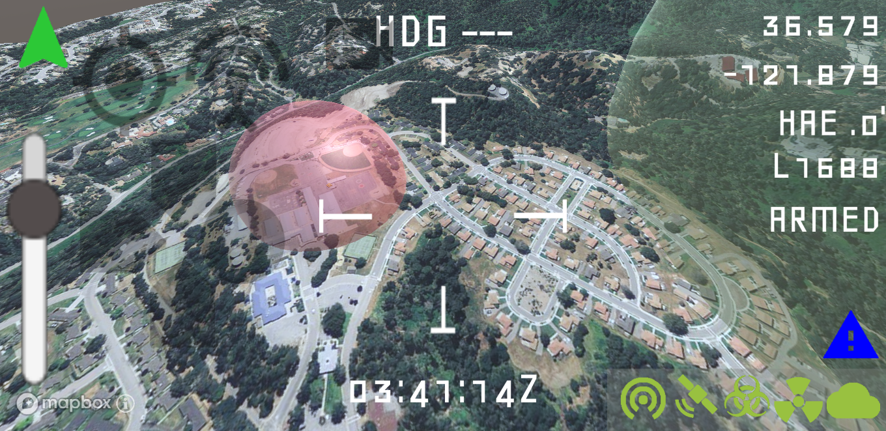
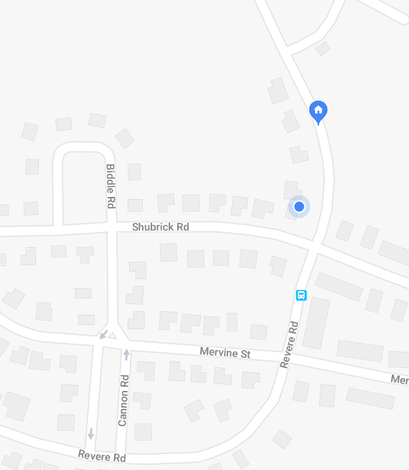
12:38
ANVIL
12:38
ANVIL

